Slide 1

Machine learning
NCSR Democritus & University of Piraeus
Ioannis Kasionis & Nikolas Kavaklis
Athens 2024

Slide 2


Who is that…
?!
NCSR Democritus & University of Piraeus
Athens 2024

Slide 3
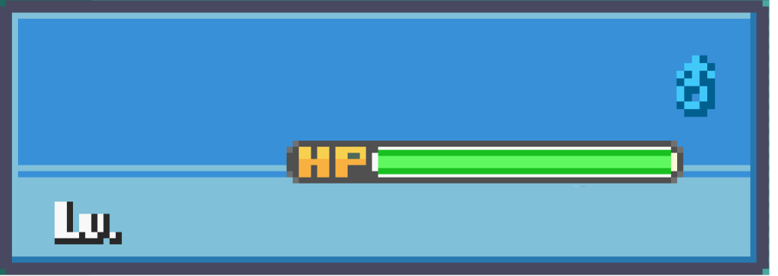
Presenters
Giannis
Nikolas
15
45/45
15
45/45

Slide 4
Hello there!

Slide 5
Today we are going on an adventure to explore our project…

Slide 6
This project is a machine learning pipeline for recognizing Pokémon in images

Slide 7
Two main stages:
Binary Classification: Detect if an image contains any Pokémon

Slide 8
Multi-class Classification: Identify the specific Pokémon species

Slide 9
Designed for modularity and experimentation on limited hardware

Slide 10



Motivation
Fine-grained recognition of visually similar objects
Avoiding the complexity of neural networks; focus on classical Machine Learning algorithms
Run on modest hardware (laptop) while still achieving reasonable performance

Slide 11
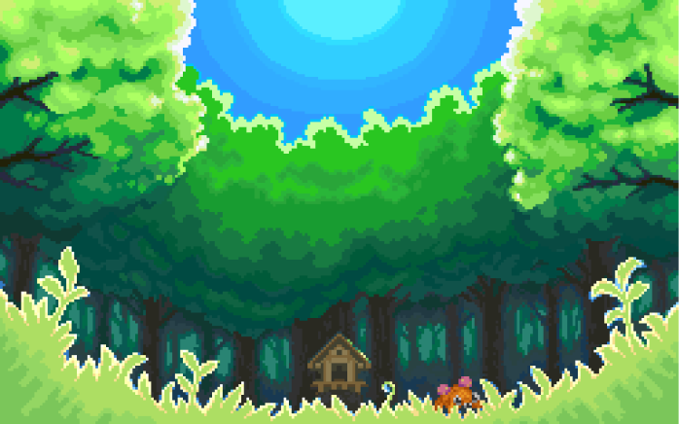

BIOME MAP
Development of the system

Slide 12

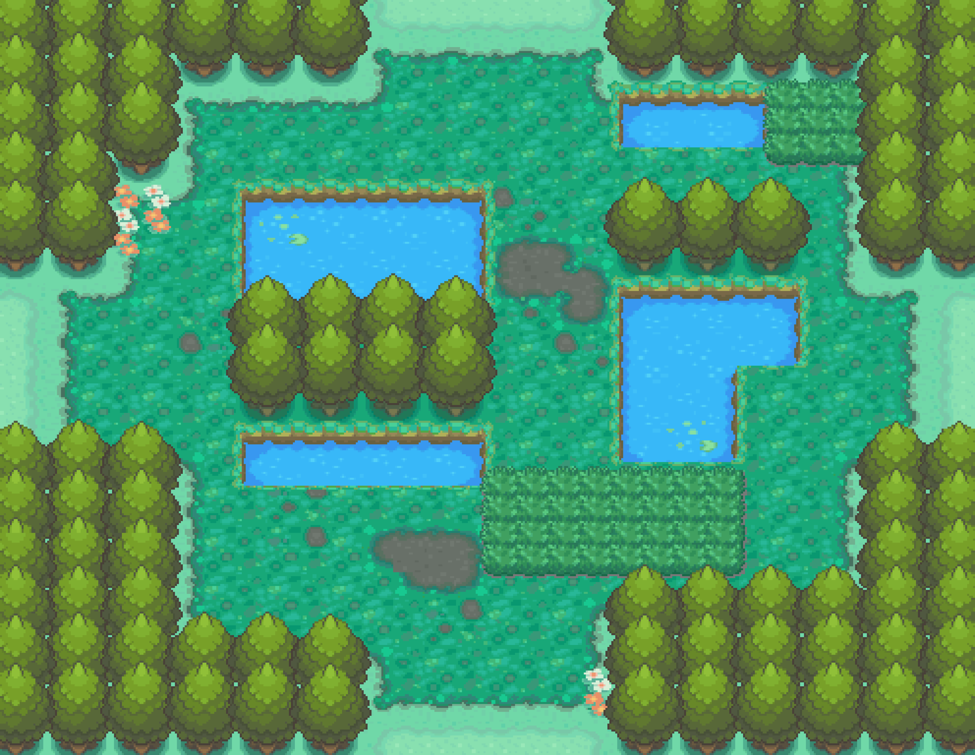









BIOME MAP
Classification of Pokémon species

Slide 13

BIOME MAP
Data augmentation

Slide 14

BIOME MAP
Feature extraction

Slide 15
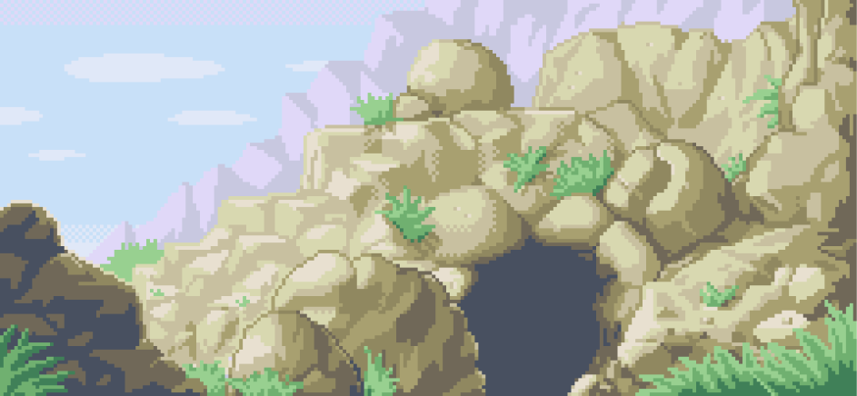
BIOME MAP
Hyperparameter tuning

Slide 16

Dataset overview
Pokémon Dataset: Organized into folders by species (e.g.
Charmander, Bulbasaur)
No-Pokémon Dataset: Contains images without any Pokémon
Varying image qualities and bit-depths

Slide 17

Data Preprocessing
Standardize image sizes (e.g. resized to 128×128)
Normalize bit-depth (convert to 8-bit RGB)
Consistent processing for both training and inference

Slide 18


Data augmentation
Augmentation techniques used:
Horizontal flipping
Random rotation (up to 30°)
Random brightness/contrast adjustments
Gaussian noise injection
Implemented via Albumentations; both original and augmented images are used for training

Slide 19
Feature Extraction
Features used:
HOG: Captures gradient and shape information
LBP: Captures texture features in LAB color
Color Histograms: In HSV and LAB spaces
Originally included SIFT features (for local descriptors), but these were disabled to reduce training time

Slide 20

HOG Features
Computes gradients in localized regions
Parameters:
Orientations: 9
Pixels per cell: 8×8
Cells per block: 2×2
Provides shape and edge information

Slide 21
LBP & Color Histograms
LBP: Computes local binary patterns for texture.
*Applied in LAB space
Color Histograms: Capture color distribution in HSV and LAB spaces
Combined features form a robust representation

Slide 22

Dimensionality Reduction (PCA)
Optional PCA step to reduce feature dimensionality
Helps speed up training and inference
Retains 95% of variance (dummy value; can be tuned)

Slide 23

Image Segmentation
Uses a recursive tiling strategy to segment images
Splits images into candidate regions that might contain a Pokémon
Ensures that small regions and background are handled appropriately

Slide 24
Binary Classification Pipeline
Determines whether an image contains any Pokémon
Uses engineered features and scaling (with optional PCA)
Hyperparameter tuning is performed (dummy scores later)

Slide 25

Multi-class Classification Pipeline
Classifies the specific Pokémon species if detected
Uses the same feature extraction and scaling pipeline
Multiple models (e.g. Random Forest, SVM, XGBoost) are evaluated

Slide 26

Hyperparameter Tuning Process
GridSearchCV is used for tuning classifier parameters
Cross-validation (3-fold) ensures robust performance
Separate grids are defined for binary and multi-class classifiers

Slide 27
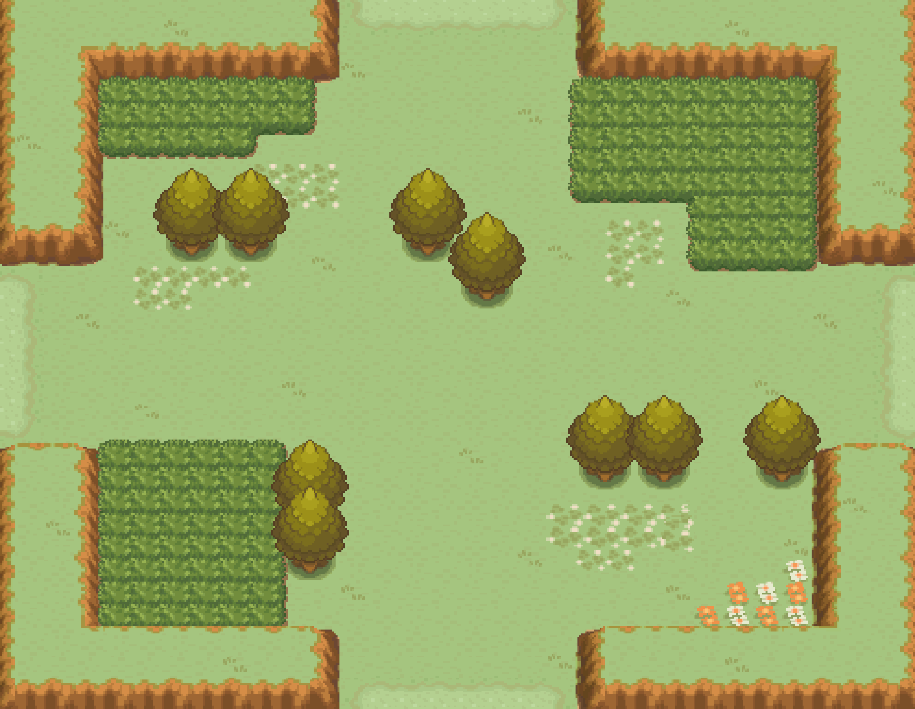


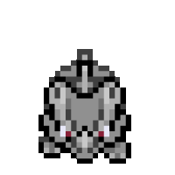






Slide 28

Binary Classifier
Model: Random Forest
Best Parameters:
n estimators = 500
max depth = 10
max features = sqrt
min samples leaf = 1
Min samples split = 2
Validation Accuracy: 93%

Slide 29
Multi-class Classifier
Model: Random Forest
Best Parameters:
n estimators = 500
max depth = 20
max features = sqrt
min samples leaf = 2
Min samples split = 2
Validation Accuracy: 75%

Slide 30

Evaluation Metrics
Binary Classification:
Accuracy: 85%
Precision: 90%
Recall: 80%
F1-Score: 85%
Multi-class Classification:
Overall Accuracy: 75%
Macro F1-Score: 74%

Slide 31

Challenges & Limitations
Features may not capture all fine-grained details
Memory and computational constraints on a laptop
Low confidence predictions and overlapping feature distributions
Limited dataset size and variability

Slide 32
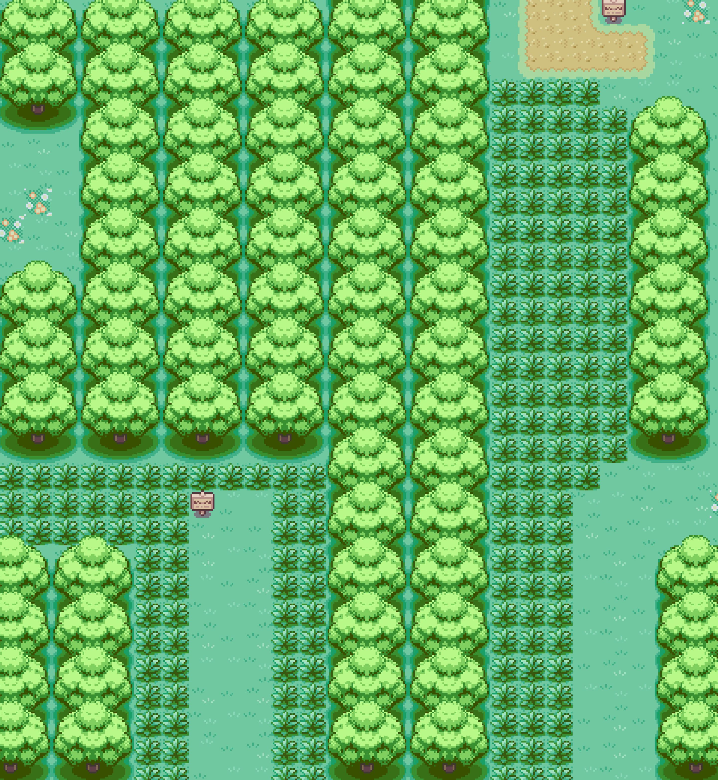













Slide 33

Future Work
Experiment with additional or dense features
Enhance data augmentation and segmentation methods
Explore hybrid approaches using pretrained deep features

Slide 34

Conclusion
The project demonstrates a modular pipeline for Pokémon recognition
Trade-offs exist between complexity and performance
Further tuning and alternative approaches may improve results

Slide 35




Which model to pick?
GENGAR
3
NIDORINO
6
50/50
XGBOOST
SVM-RBF
RANDOM FOREST
kNN

